Slide 1
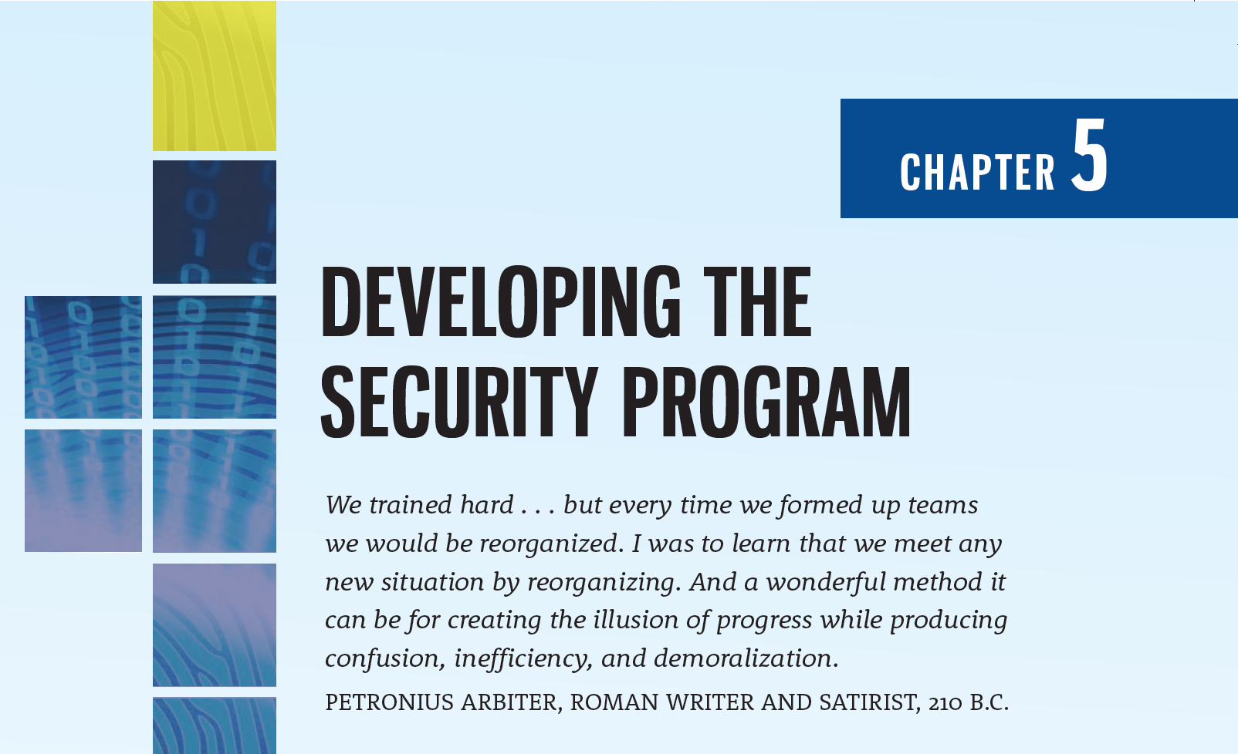

Slide 2
Learning Objectives
Upon completion of this material, you should be able to:
List and describe the functional components of an information security program
Discuss how to plan and staff an organization’s information security program based on its size
Explain the internal and external factors that influence the activities and organization of an information security program
List and describe the typical job titles and functions performed in the information security program
Discuss the components of a security education, training, and awareness program and explain how organizations create and manage these programs
Discuss the role of project management in information security
Notes:
Learning Objectives
Upon completion of this material you should be able to:
Recognize and understand the organizational approaches to information security
List and describe the functional components of the information security program
Determine how to plan and staff an organization’s information security program based on its size
Evaluate the internal and external factors that influence the activities and organization of an information security program
List and describe the typical job titles and functions performed in the information security program
Describe the components of a security education, training, and awareness program and understand how organizations create and manage these programs

Slide 3
Organizing for Security
Chapter 05: Developing the Security Program

Slide 4
Organizing for Security
Some organizations use the term “security program” to describe the entire set of personnel, plans, policies, and initiatives related to information security
The term “information security program” is used here to describe the structure and organization of the effort to manage risks to an organization’s information assets

Slide 5
Organizing for Security (Continued)
Among the variables that determine how to structure an InfoSec program are organizational culture, size, security personnel budget, and security capital budget
“…as organizations get larger in size, their security departments are not keeping up with the demands of increasingly complex organizational infrastructures. Security spending per user and per machine declines exponentially as organizations grow, leaving most handcuffed when it comes to implementing effective security procedures”

Slide 6
Functions Needed to Implement the InfoSec Program
Risk assessment
Risk management
Systems testing
Policy
Legal assessment
Incident response
Planning
Measurement
Compliance
Centralized authentication
Systems security administration
Training
Network security administration
Vulnerability assessment

Slide 7
Security in Large Organizations
Information security departments in such organizations tend to form and re-form internal groups to meet long-term challenges even as they handle day-to-day security operations
Functions are likely to be split into groups in contrast to smaller organizations, which typically create fewer groups, perhaps only having one general group of specialists

Slide 8
Security in Large Organizations (Continued)
One recommended approach is to separate the functions into those performed:
By nontechnology business units outside the IT area of management control, such as legal and training
By IT groups outside the InfoSec area of management control, such as systems security administration, network security administration, and centralized authentication
Within the InfoSec department as a customer service to the organization and its external partners such as risk assessment, systems testing, incident response planning, disaster recovery planning, performance measurement, and vulnerability assessment
Within the InfoSec department as a compliance enforcement obligation, such as policy, compliance/audit, and risk management

Slide 9
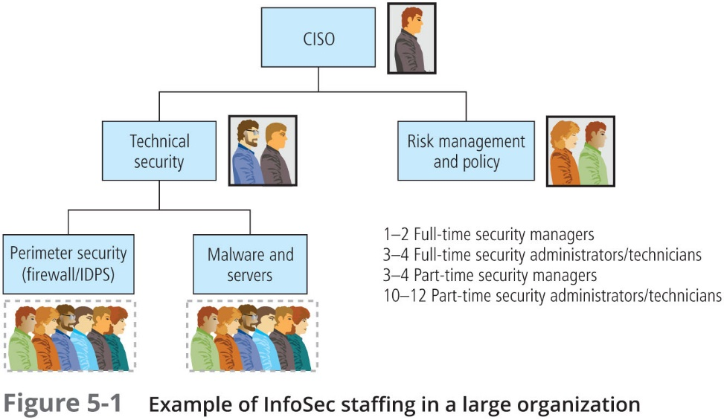

Slide 10
Security in Large Organizations (Continued)
It remains the CISO’s responsibility to see that information security functions are adequately performed somewhere within the organization
The deployment of full-time security personnel depends on a number of factors, including sensitivity of the information to be protected, industry regulations, and general profitability
The more money the company can dedicate to its personnel budget, the more likely it is to maintain a large information security staff

Slide 11
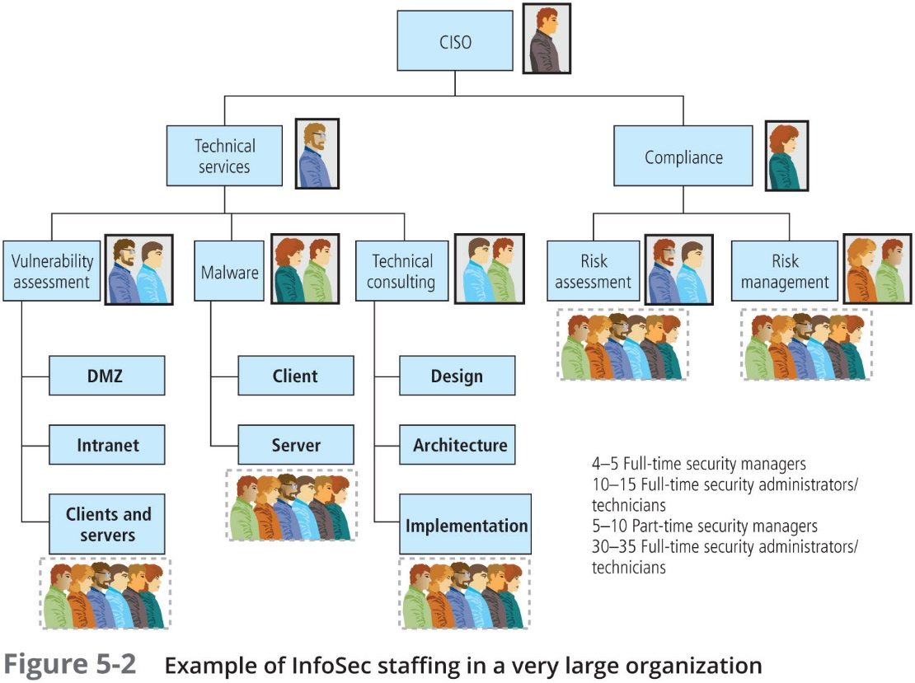

Slide 12
Security in Medium-Sized Organizations
Medium-sized organizations may still be large enough to implement the multi-tiered approach to security described for large organizations, though perhaps with fewer dedicated groups and more functions assigned to each group
In a medium-sized organization, more of the functional areas are assigned to other departments within IT but outside the InfoSec department
The medium-sized organization may only have one full-time security person, with perhaps three individuals with part-time InfoSec responsibilities

Slide 13
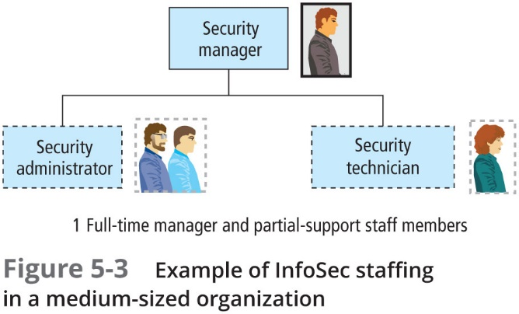

Slide 14
Security in Small Organizations
In a small organization, InfoSec often becomes the responsibility of a jack-of-all-trades, a single security administrator with perhaps one or two assistants for managing the technical components
It is not uncommon in smaller organizations to have the systems or network administrators perform these many roles
Because resources are often limited in smaller organizations, the security administrator frequently turns to freeware or open source software to lower the costs of assessing and implementing security

Slide 15
Security in Small Organizations (Continued)
Some feel that small organizations, to their advantage, avoid some threats precisely because of their small size
Threats from insiders are also less likely in an environment where every employee knows every other employee
In general, the less anonymity an employee has, the less likely he or she feels able to get away with abuse or misuse of company assets
Smaller organizations typically have either one individual who has full-time duties in InfoSec or, more likely, one individual who manages or conducts InfoSec duties in addition to those of other functional areas, most likely IT, possibly with one or two assistants

Slide 16
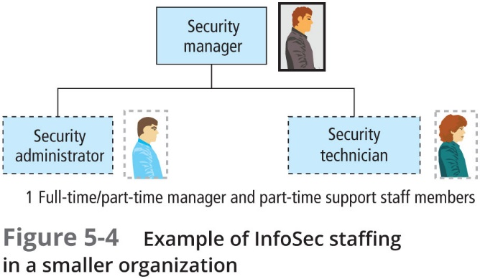

Slide 17
Placing Information Security Within an Organization
Chapter 05: Developing the Security Program

Slide 18
Placing Information Security Within an Organization
In large organizations, InfoSec is often located within an IT division headed by the CISO, who reports directly to the CIO
By its very nature, an InfoSec program is sometimes at odds with the goals and objectives of the IT department as a whole
Because the goals and objectives of the CIO and the CISO may come in conflict, the current movement is to separate InfoSec from the IT division
The challenge is to design a reporting structure for the InfoSec program that balances the competing needs of each of the communities of interest

Slide 19
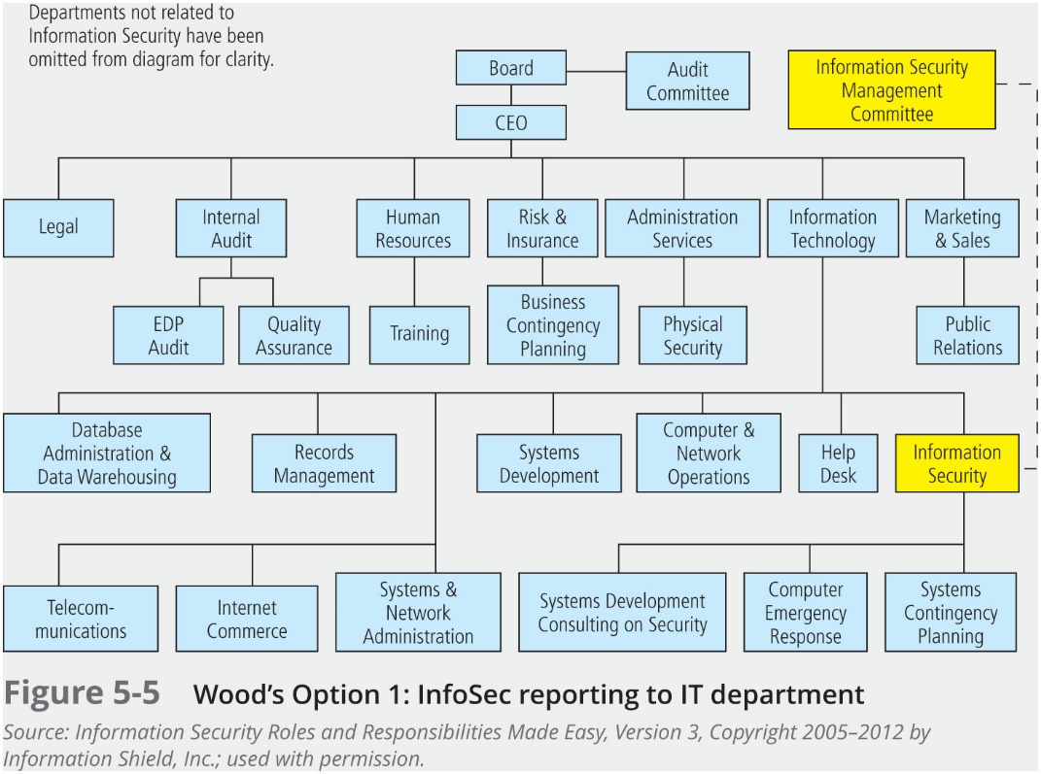

Slide 20
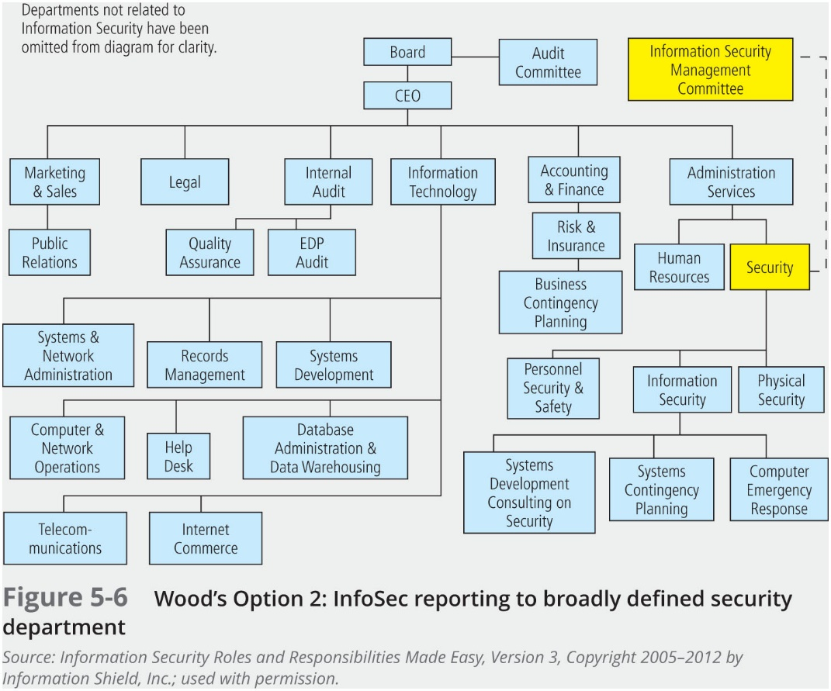

Slide 21
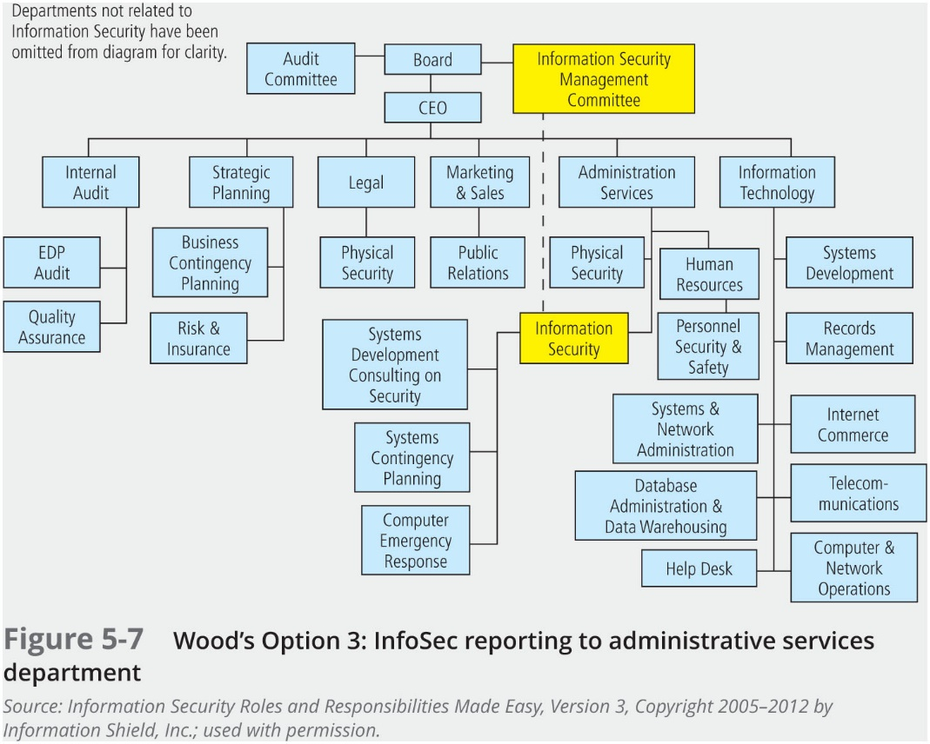

Slide 22
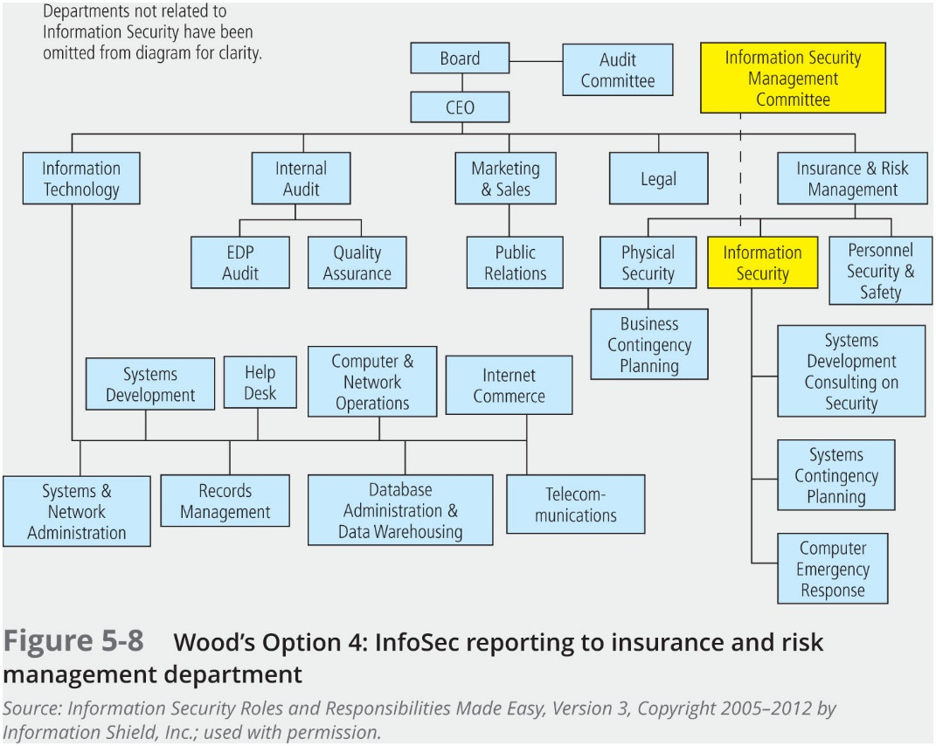

Slide 23
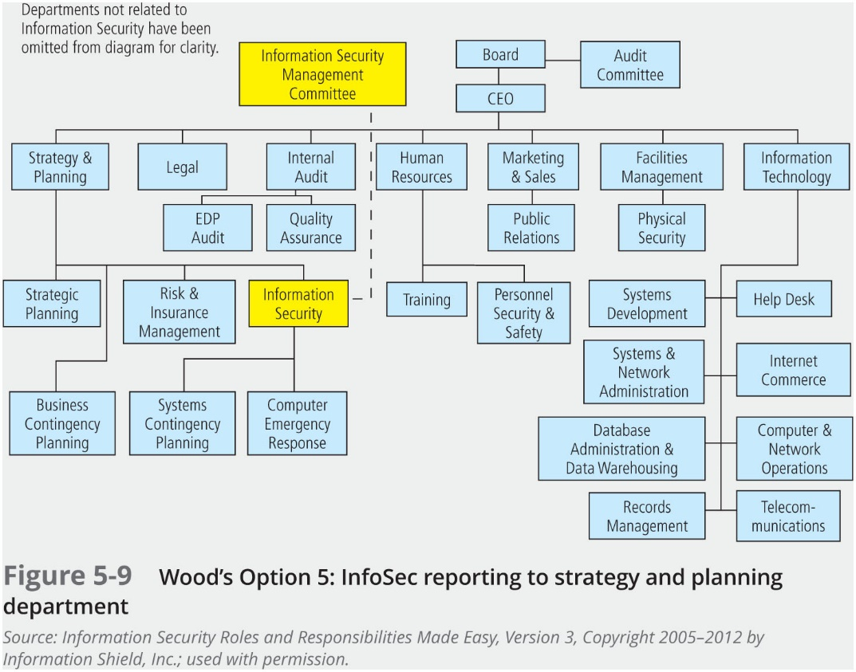

Slide 24
Other Options
Option 6: Legal Department
Option 7: Internal Audit Department
Option 8: Help Desk
Option 9: Accounting and Finance Department via IT
Option 10: Human Resources Department
Option 11: Facilities Management Department
Option 12: Operations Approach

Slide 25
Components of the Security Program
Chapter 05: Developing the Security Program

Slide 26
Components of the Security Program
The information security needs of any organization are unique to its culture, size, and budget
Determining the level at which the InfoSec program operates on depends on the organization’s strategic plan, and in particular on the plan’s vision and mission statements
The CIO and CISO should use these two documents to formulate the mission statement for the information security program

Slide 27
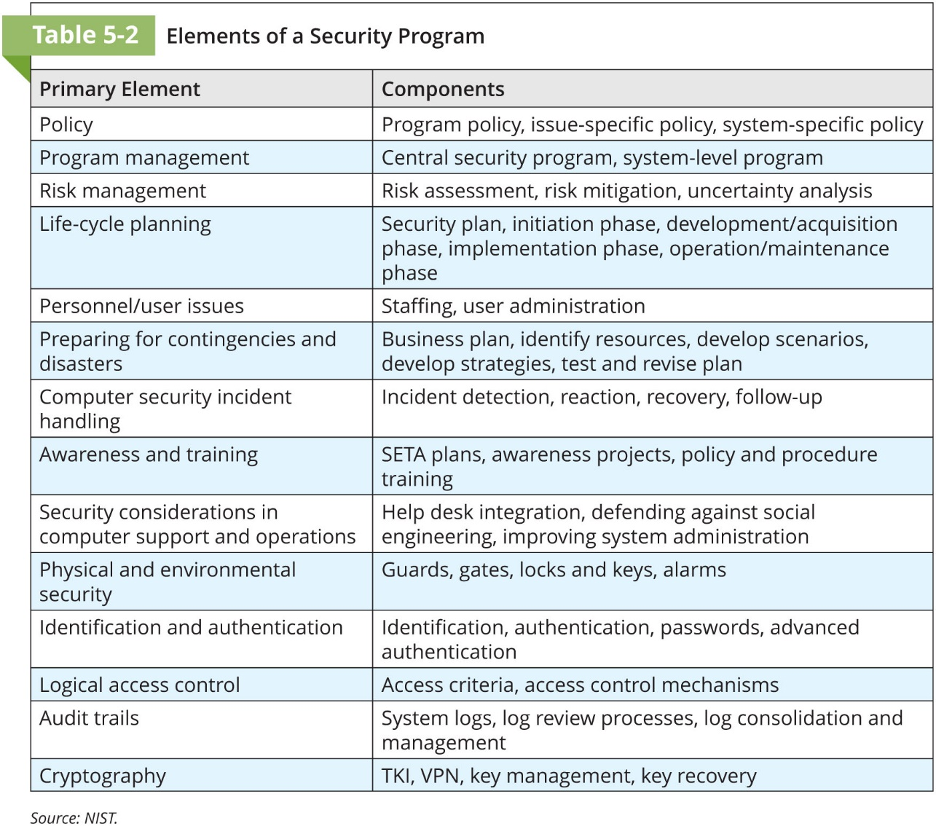

Slide 28
Staffing the Security Function
Chapter 05: Developing the Security Program

Slide 29
Staffing the Security Function
Selecting an effective mix of InfoSec personnel for an organization requires that you consider a number of criteria; including the supply and demand of various skills and experience levels
When demand for personnel with critical InfoSec skills rises quickly, supply often fails to meet it; as demand becomes known, professionals seek to gain the required skills, experience, and credentials
Until supply can meet demand, competition for the scarce resource will continue to drive up costs
Once the supply is level with or higher than demand, organizations can become more selective and no longer need to pay a premium for those skills
This process swings back and forth because the real economy, unlike an econometric model, is seldom in equilibrium for long

Slide 30
Defining the Qualifications and Requirements
Due to the relatively recent emergence of InfoSec as a distinct discipline, many organizations are still not certain which qualifications competent InfoSec personnel should have
In many cases, the InfoSec staff lacks established roles and responsibilities
In most cases, organizations look for a technically qualified InfoSec generalist with a solid understanding of how organizations operate
In InfoSec, overspecialization may actually be a drawback

Slide 31
Information Security Positions
According to Schwartz et al., InfoSec positions can be classified into one of three types: those that define, those that build, and those that administer:
Definers provide the policies, guidelines, and standards
They’re the people who do the consulting and the risk assessment, who develop the product and technical architectures
These are senior people with a lot of broad knowledge, but often not a lot of depth
Then you have the builders
They’re the real techies, who create and install security solutions
Finally, you have the people who operate and administrate the security tools, the security monitoring function, and the people who continuously improve the processes

Slide 32
Information Security Positions (Continued)
A typical organization has a number of individuals with information security responsibilities
While the titles used may be different, most of the job functions fit into one of the following:
Chief information security officer (CISO) or chief security officer (CSO)
Security managers
Security administrators and analysts
Security technicians
Security staffers and watchstanders
Security consultants
Security officers and investigators
Help desk personnel

Slide 33
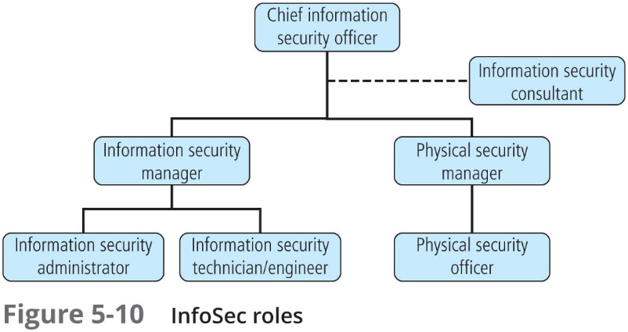
Notes:
Representative example of a possible organization of roles.

Slide 34
Chief Information Security Officer
The chief information security officer (CISO), or in some cases, the CSO, is usually the top InfoSec officer in the organization and is the spokesperson for the security team and responsible for the overall InfoSec program
The senior executive responsible for security may also be called the director of security, senior security manager, or some similar title
The CISO usually reports directly to the CIO, although in larger organizations one or more additional layers of management may separate the two officers

Slide 35
Convergence and the Rise of the True CSO
Some organizations use the title “chief security officer” to describe the CISO
The more mature (and often larger) organization will use the CSO title to identify a role that is responsible for the convergence of the physical and IT risks into one complete program to control all those risks
Some, however, will simply call the senior executive for physical security the CSO and define a role for the CSO that is not integrated into a holistic risk management program

Slide 36
Security Managers
Security managers are accountable for the day-to-day operations of the InfoSec program
They accomplish objectives identified by the CISO, to whom they and they resolve issues identified by technicians, administrators, analysts, or staffers whom they supervise
Managing security requires an understanding of technology but not necessarily technical mastery

Slide 37
Security Administrators and Analysts
The security administrator is a hybrid of a security technician and a security manager, with both technical knowledge and managerial skill
The security analyst is a specialized security administrator that, in addition to performing security administration duties, must analyze and design security solutions within a specific domain
Security analysts must be able to identify users’ needs and understand the technological complexities and capabilities of the security systems they design

Slide 38
Security Technician
A security technician is a technically qualified individual who may configure firewalls and IDPSs, implement security software, diagnose and troubleshoot problems, and coordinate with systems and network administrators to ensure that security technical controls are properly implemented
A security technician is typically an entry-level position, but one that requires a certain level of technical skills, which can be difficult to obtain without experience
Security technicians who want to move up in the corporate hierarchy must expand their technical knowledge horizontally and obtain an understanding of the general organizational side of InfoSec as well as all technical areas

Slide 39
Security Staffers and Watchstanders
Security staffer is a catchall title that applies to those who perform routine watchstanding or administrative activities
The term “watchstander” includes the people who monitor technical security controls and systems and perform other administrative yet critical roles that support the mission of the InfoSec department
Security watchstanders are often entry-level InfoSec professionals responsible for monitoring some aspect of the organization’s security posture, whether technical or managerial
In this position, new InfoSec professionals have the opportunity to learn more about the organization’s InfoSec program before becoming critical components of its administration

Slide 40
Security Consultants
The InfoSec consultant is typically an independent expert in some aspect of InfoSec
He or she is usually brought in when the organization makes the decision to outsource one or more aspects of its security program
While it is usually preferable to involve a formal managed security services (MSS) company, qualified individual consultants are available for hire to organizations that do not choose to hire an MSS company
Notes:
.

Slide 41
Security Officers and Investigators
Occasionally, the physical security and InfoSec programs are blended into a single, converged functional unit
When that occurs, several roles are added to the pure IT security program, including physical security officers and investigators
Sometimes referred to as the guards, gates, and guns (GGG) aspect of security, these roles are often closely related to law enforcement and may rely on employing persons trained in law enforcement and/or criminal justice

Slide 42
Help Desk Personnel
An important part of the information security team is the help desk, which enhances the security team’s ability to identify potential problems
When a user calls the help desk with a complaint about his or her computer, the network, or an Internet connection, the user’s problem may turn out to be related to a bigger problem, such as a hacker, denial-of-service attack, or a virus
Because help desk technicians perform a specialized role in information security, they may need specialized training

Slide 43
Information Security Professional Credentials
Chapter 05: Developing the Security Program

Slide 44
Information Security Professional Credentials
Many organizations rely to some extent on recognizable professional certifications to ascertain the level of knowledge and experience possessed by any given candidate
Because some certification programs are relatively new, their precise value is not fully understood by most hiring organizations
The certifying bodies work diligently to educate their constituent communities on the value and qualifications of their certification recipients
Employers struggle to match certifications to position requirements, while potential information security workers try to determine which certification programs will help them in the job market

Slide 45
(ISC)² Certifications
The International Information Systems Security Certification Consortium (ISC)² offers several managerial security-related certifications, among them:
Certified Information Systems Security Professional (CISSP)
Systems Security Certified Practitioner (SSCP)
Certified Authorization Professional (CAP)
Certified Cyber Forensics Professional (CCFP)
Certified Cloud Security Professional (CCSP)
Certified Secure Software Lifecycle Professional (CSSLP)
Health Care Information Security and Privacy Practitioner (HCISPP)

Slide 46
Certified Information Systems Security Professional (CISSP)
Considered one of the most prestigious certification for security managers and CISOs, the CISSP certification recognizes mastery of an internationally recognized common body of knowledge (CBK) in information security, covering these domains:
Asset Security
Communications and Network Security
Identity and Access Management
Security and Risk Management
Security Assessment and Testing
Security Engineering
Security Operations
Software Development Security

Slide 47
CISSP Concentrations
ISSAP®: Information Systems Security Architecture Professional—The CISSP-ISSAP is an appropriate credential for Chief Security Architects and Analysts who may typically work as independent consultants or in similar capacities
ISSEP®: Information Systems Security Engineering Professional—The CISSP-ISSEP credential was developed in conjunction with the U.S. National Security Agency (NSA) providing an invaluable tool for any systems security engineering professional
ISSMP®: Information Systems Security Management Professional Enterprise Security Management Practice—The CISSP-ISSMP credential contains deep managerial elements, such as project management, risk management, setting up and delivering a security awareness program, and managing a business continuity planning program Source: (ISC)²

Slide 48
Systems Security Certified Practitioner (SSCP)
The SSCP certification is more applicable to an entry-level security manager than a technician, as the bulk of its questions focus on the operational InfoSec
The SSCP focuses “on practices, roles, and responsibilities as defined by experts from major IS industries” and covers seven domains:
Access controls
Cryptography
Incident response and recovery
Networks and communications security
Risk identification, monitoring, and analysis
Security operations and administration
Systems and applications security

Slide 49
Other (ISC)² Certifications
In addition to the CISSP and its concentrations, and the SSCP, (ISC)² offers additional, specialized certifications:
Certified Authorization Professional (CAP)—For individuals responsible for maintaining and authorizing systems
Certified Cyber Forensics Professional (CCFP)—For individuals with digital forensics responsibility
Certified Cloud Security Professional (CCSP)—For individuals with responsibility for cloud-based systems security
Certified Secure Software Lifecycle Professional (CSSLP)—For individuals with responsibility for the development and implementation of secure software
Health Care Information Security and Privacy Practitioner (HCISPP)—For individuals working in the healthcare field or with responsibilities to manage, audit, or secure healthcare systems

Slide 50
ISACA Certifications
Formerly known as the Information Systems Audit and Control Association, ISACA promotes four certifications:
Certified Information Security Manager (CISM)
Certified Information Security Auditor (CISA)
Certified in the Governance of Enterprise IT (CGEIT)
Certified in Risk and Information Systems Control (CRISC)

Slide 51
Certified Information Security Manager (CISM)
The CISM credential is geared toward experienced information security managers and others who may have information security management responsibilities
The CISM can assure executive management that a candidate has the required background knowledge needed for effective security management and consulting
The CISM exam covers:
Information security governance
Information risk management
Information security program development and management
Information security incident management

Slide 52
Certified in the Governance of IT (CGEIT)
ISACA’s Certified in the Governance of IT (CGEIT) certification is targeted at upper-level executives, including CISOs and CIOs, directors, and consultants with knowledge and experience in IT governance
The exam covers the following areas:
Framework for the governance of enterprise IT
Strategic management
Benefits realization
Risk optimization
Resource optimization

Slide 53
Certified in Risk and Information Systems Controls (CRISC)
The CRISC prepares and enables IT professionals for the challenges of IT and enterprise risk management
CRISC certification exam tests applicants over the following domains:
IT risk identification
IR risk assessment
Risk response and mitigation
Risk and control monitoring and reporting
Applicants must also have three years experience in risk management and IS control

Slide 54
Certified Information Systems Auditor (CISA)
ISACA promotes the CISA as being appropriate for auditing, networking, and security professionals
The exam covers the following areas of information systems auditing:
The process of auditing information systems
Governance and management of IT
Information systems acquisition, development, and implementation
Information systems operations, maintenance, and support
Protection of information assets

Slide 55
GIAC Certifications
The System Administration, Networking, and Security Organization (SANS) has developed a series of technical security certifications known as the Global Information Assurance Certification (GIAC)
The organization now classifies its training branch as SANS and certification branch as GIAC
GIAC certifications are organized into five domains:
Developer
Cyber defense
Penetration testing
Digital Forensics and incident response
Management and leadership
The GIAC certifications can be pursued independently or combined to earn a comprehensive certification called GIAC Security Engineer (GSE) and enhanced at “Gold” status

Slide 56
EC-Council Certifications
EC-Council’s C|CISO tests not only security domain knowledge but also executive business management knowledge
The C|CISO domains include the following:
Domain 1: Governance
Domain 2: IS management controls and auditing management
Domain 3: Information security leadership—projects and operations
Domain 4: Information security core competencies
Domain 5: Strategic planning and finance
Individuals who are interested in the C|CISO certification but have not yet met the experience requirements can consider the Information Security Manager (E|ISM) certification

Slide 57
CompTIA Certifications
The Computing Technology Industry Association (CompTIA)—the organization that offered the first vendor-neutral professional IT certifications, the A+ series—now offers several security-related certifications:
Security+
Cybersecurity Analyst+
CompTIA Advanced Security Practitioner (CASP)

Slide 58
Certification Costs
Certifications cost money, and the more preferred certifications can be expensive
Given the nature of the knowledge needed to pass the examinations, most experienced professionals find it difficult to do well without at least some review
Certifications are designed to recognize experts in their respective fields, and the cost of certification deters those who might otherwise take the exam just to see if they can pass
Most examinations require between two and three years of work experience, and they are often structured to reward candidates who have significant hands-on experience

Slide 59
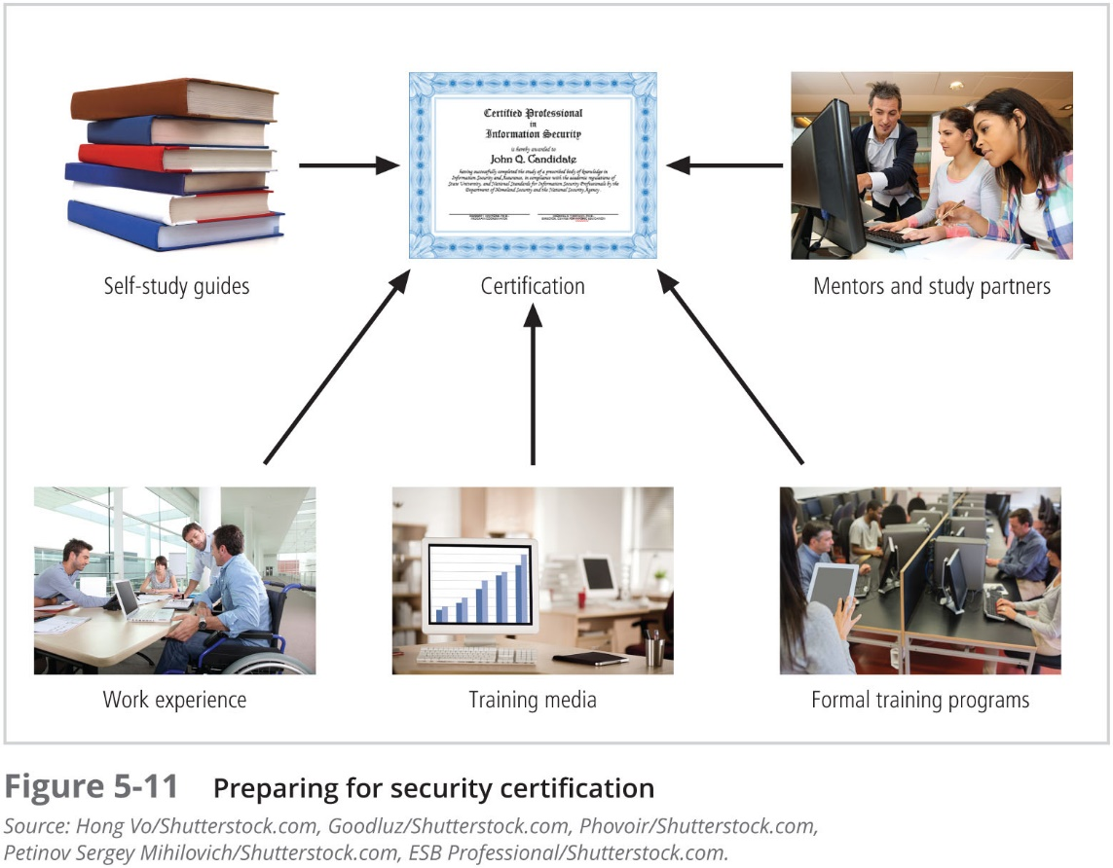

Slide 60
Entering the Information Security Profession
Many information security professionals enter the field after having prior careers in law enforcement or the military, or careers in other IT areas, such as networking, programming, database administration, or systems administration
Organizations can foster greater professionalism in the information security discipline by clearly defining their expectations and establishing explicit position descriptions

Slide 61
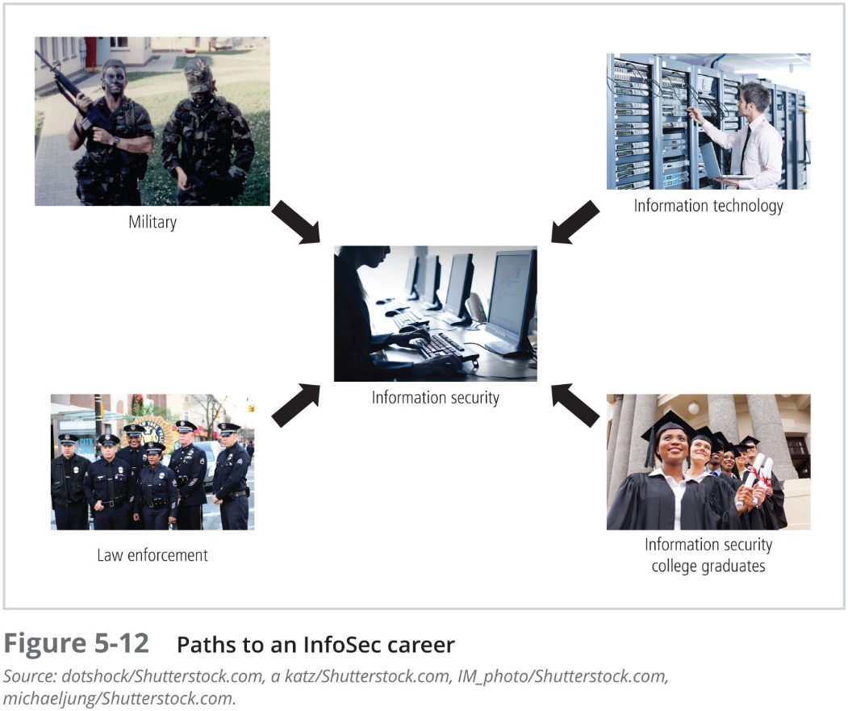

Slide 62
Implementing Security Education, Training, and Awareness (SETA) Programs
Chapter 05: Developing the Security Program

Slide 63
Implementing Security Education, Training, and Awareness Programs
The SETA program is designed to reduce accidental security breaches by members of the organization
SETA programs offer three major benefits:
They can improve employee behavior
They can inform members of the organization about where to report violations of policy
They enable the organization to hold employees accountable for their actions
The purpose of SETA is to enhance security:
By building in-depth knowledge, as needed, to design, implement, or operate security programs for organizations and systems
By developing skills and knowledge so that computer users can perform their jobs while using IT systems more securely
By improving awareness of the need to protect system resources

Slide 64
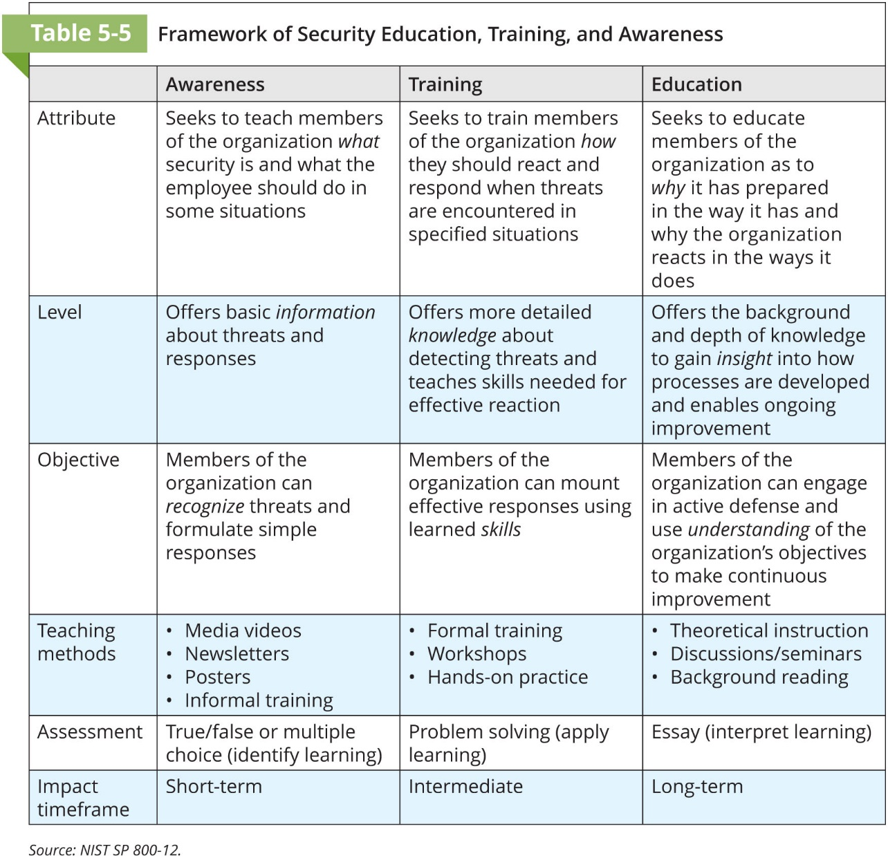

Slide 65
Security Education
Some organizations may have employees within the InfoSec department who are not prepared by their background or experience for the InfoSec roles they are supposed to perform
When circumstances allow and/or strategic imperatives dictate, these employees may be encouraged to use a formal education method
Because many institutions have no frame of reference for the knowledge and skills that are required for a particular job area, they frequently refer to the certifications offered in that field

Slide 66
Security Training
Security training involves providing members of the organization with detailed information and hands-on instruction to enable them to perform their duties securely
Management can either develop customized training or outsource all or part of the training program
There are two methods for customizing training for users:
Functional background:
General user
Managerial user
Technical user
Skill level:
Novice
Intermediate
Advanced

Slide 67
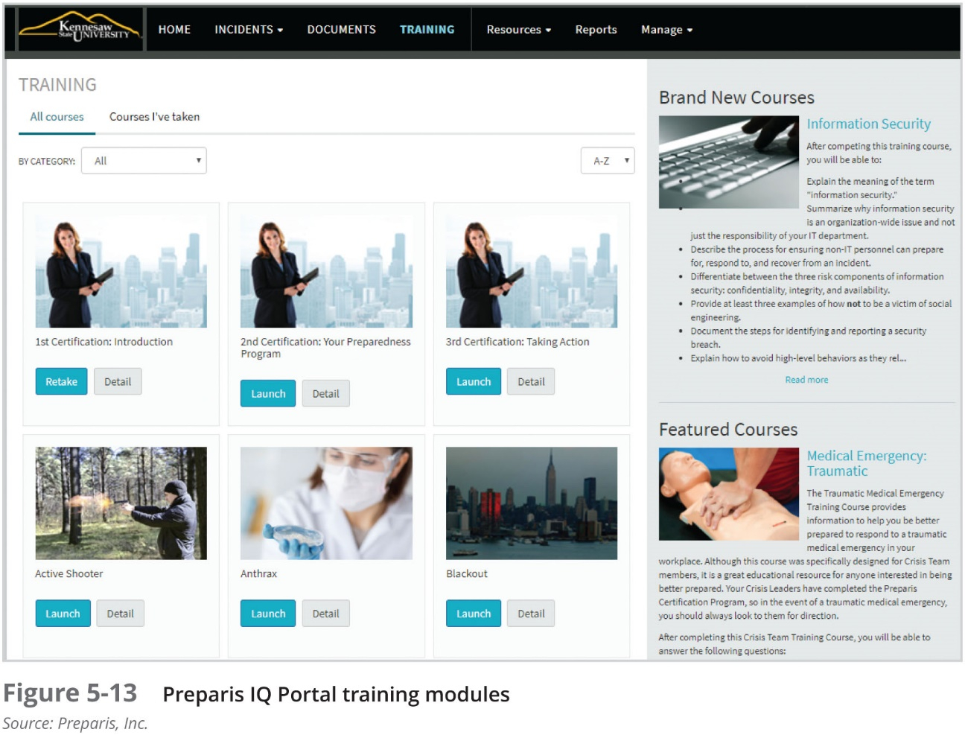

Slide 68
Delivery Methods
Selection of the training delivery method is not always based on the best outcome for the trainee
Often other factors—budget, scheduling, and needs of the organization—come first
One-on-One
Formal Class
Computer-Based Training (CBT)
Distance Learning/Web Seminars
User Support Group
On-the-Job Training
Self-Study (Noncomputerized)

Slide 69
Implementing Training
While each organization develops its own strategy based on the techniques discussed above, the following seven-step methodology generally applies:
Step 1: Identify program scope, goals, and objectives
Step 2: Identify training staff
Step 3: Identify target audiences
Step 4: Motivate management and employees
Step 5: Administer the program
Step 6: Maintain the program
Step 7: Evaluate the program

Slide 70
Security Awareness
One of the least frequently implemented, but most effective security methods, is the security awareness program
Security awareness programs:
set the stage for training by changing organizational attitudes to realize the importance of security and the adverse consequences of its failure;
remind users of the procedures to be followed

Slide 71
Security Awareness (Continued)
When developing an awareness program:
Focus on people
Refrain from using technical jargon
Use every available venue
Define learning objectives, state them clearly, and provide sufficient detail and coverage
Keep things light
Don’t overload the users
Help users understand their roles in InfoSec
Take advantage of in-house communications media
Make the awareness program formal; plan and document all actions
Provide good information early, rather than perfect information late

Slide 72
Employee Behavior and Awareness
Security awareness and security training are designed to modify any employee behavior that endangers the security of the organization’s information
Security training and awareness activities can be undermined, however, if management does not set a good example
Effective training and awareness programs make employees accountable for their actions
Warning employees that misconduct, abuse, and misuse of information resources will not be tolerated and that the organization will not defend employees who engage in this behavior can help indemnify the institution against lawsuits

Slide 73
Awareness Techniques
Awareness can take on different forms for particular audiences
A security awareness program can use many methods to deliver its message
Effective security awareness programs need to be designed with the recognition that people tend to practice a tuning out process (acclimation) and for this reason, awareness techniques should be creative and frequently changed

Slide 74
Developing Security Awareness Components
Many security awareness components are available at little or no cost—others can be very expensive if purchased externally
Security awareness components include the following items:
Videos
Posters and banners
Lectures and conferences
Computer-based training
Newsletters
Brochures and flyers
Trinkets (coffee cups, pens, pencils, T-shirts)
Bulletin boards
Web site

Slide 75
Security Awareness Conference/Presentations
Another means of renewing the information security message is to have a guest speaker or even a mini-conference dedicated to the topic—perhaps in association with the formal computer security days:
International Computer Security Day—November 30
National Computer Security Days—October 31 and April 4

Slide 76
Project Management in InfoSec
Chapter 05: Developing the Security Program

Slide 77
Project Management
How can information security be both a process and a project? It is, in fact, a continuous series, or chain, of projects
Some aspects of information security are not project based; rather, they are managed processes (operations) and are ongoing
Projects are discrete sequences of activities with starting points and defined completion points
A project is different from a process in that it is a temporary activity that is used to create a specific product, service, or end result, but may be repeated

Slide 78
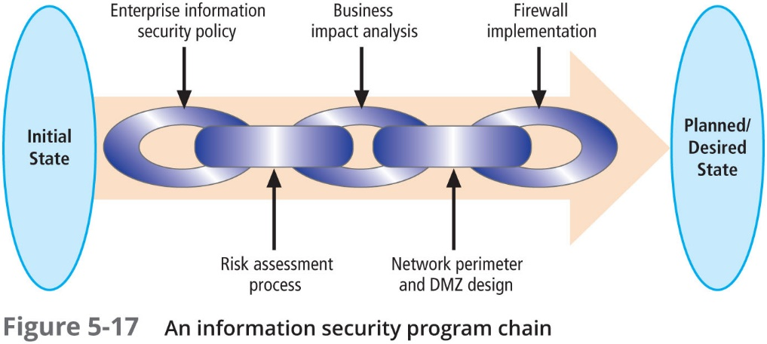

Slide 79
Project Management (Continued)
W.R. Duncan’s A Guide to the Project Management Body of Knowledge defines project management as:
the application of knowledge, skills, tools, and techniques to project activities to meet project requirements. Project management is accomplished through the use of processes such as: initiating, planning, executing, controlling, and closing
Project management involves the temporary assemblage resources to complete a project
Some projects are iterative and occur regularly

Slide 80
Project Management (Continued)
Organizations that make project management skills a priority benefit in the following ways:
Implementing a methodology ensures that no steps are missed
Creating a detailed blueprint of project activities provides a common reference tool and makes all project team members more productive by shortening the learning curve when getting projects underway
Identifying specific responsibilities for all the involved personnel reduces ambiguity and also reduces confusion
Clearly defining project constraints and minimum quality requirements increases the likelihood that the project will stay within them
Establishing performance measures and creating project milestones simplifies project monitoring
Identifying deviations in quality, time, or budget early on enables early correction of the problems

Slide 81
Project Management (Continued)
Successful project management relies on careful and realistic project planning coupled with aggressive, proactive control
Project success may be defined differently in each organization, but in general a project is deemed a success when:
It is completed on time or early
It is completed at or below its budgeted amount
It meets all specifications outlined in the approved project definition, and the deliverables are accepted by the end user and/or assigning entity
Regardless of the approach, the goal is the same: to have all elements of the InfoSec program completed with quality deliverables, on a timely basis, and within budget

Slide 82
PMBoK Knowledge Areas
To apply project management to InfoSec, you must first identify an established project management methodology
While other project management approaches exist, the PMBoK, promoted by the Project Management Institute (PMI) is considered the industry best practice

Slide 83
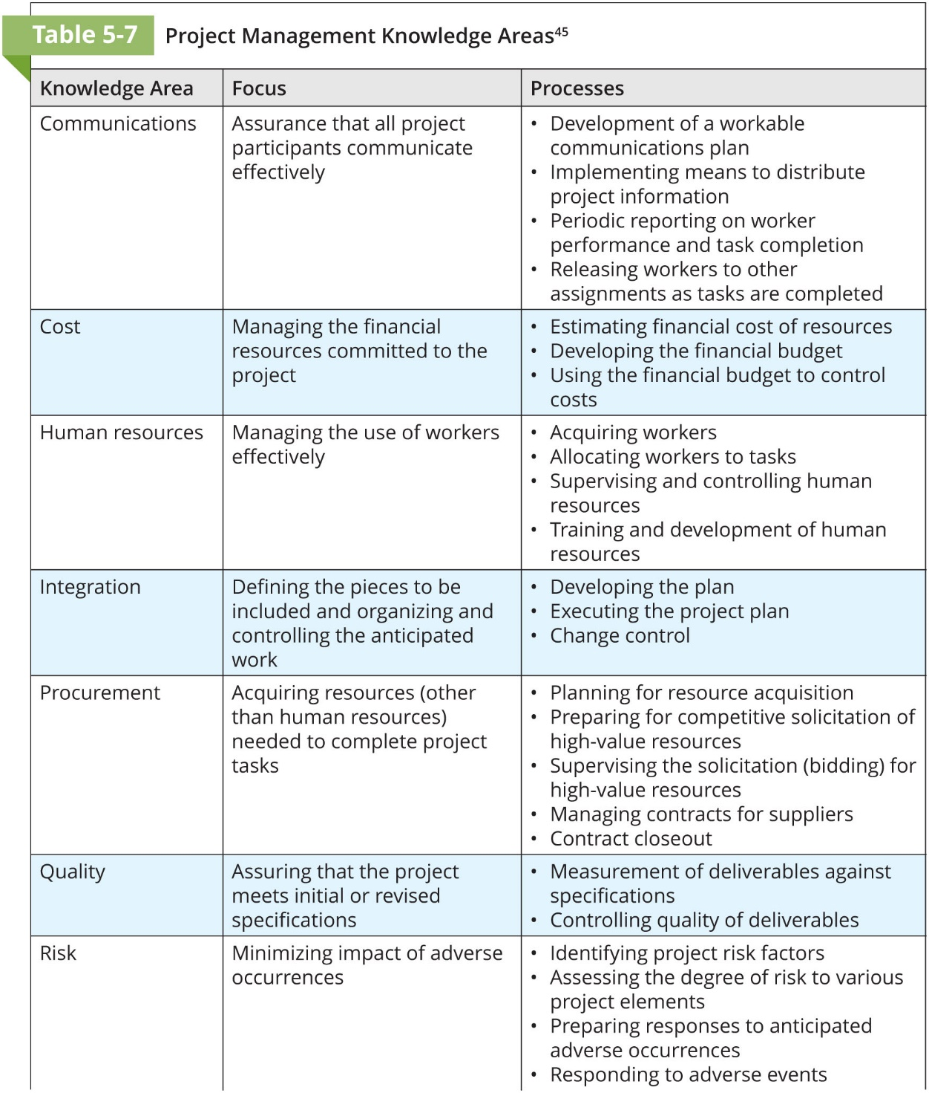

Slide 84
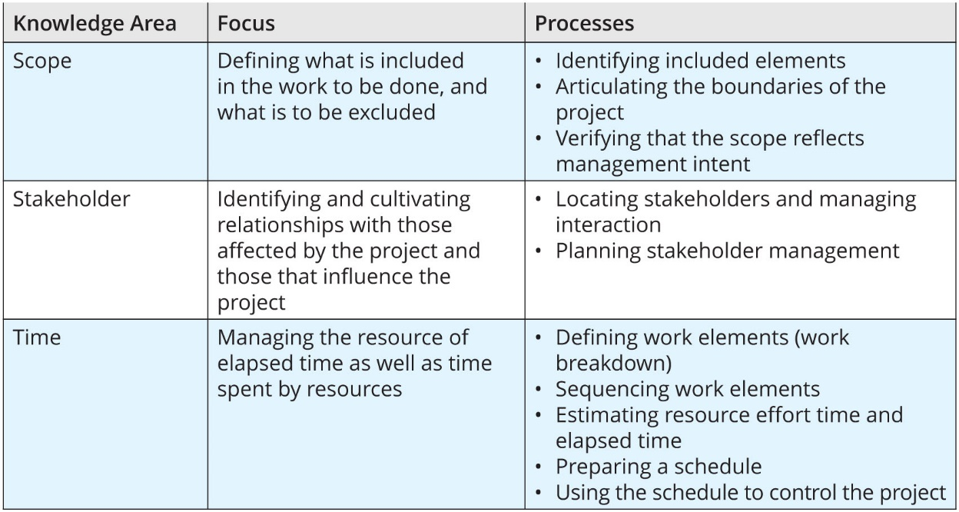
Table 5-7 Project Management Knowledge Areas (Continued)

Slide 85
Project Management Tools
There are many tools that support the management of the diverse resources in complex projects
Most project managers combine software tools that implement one or more of the dominant modeling approaches
Projectitis occurs when the project manager spends more time documenting project tasks, collecting performance measurements, recording project task information, and updating project completion forecasts than accomplishing meaningful project work

Slide 86
Work Breakdown Structure
A project plan can be created using a very simple planning tool, such as the work breakdown structure (WBS)
In the WBS approach, the project plan is first broken down into a few major tasks. Each of these major tasks is placed on the WBS task list
The minimum attributes that should be determined for each task are:
The work to be accomplished (activities and deliverables)
Estimated amount of effort required for completion in hours or workdays
The common or specialty skills needed to perform the task
Task interdependencies

Slide 87
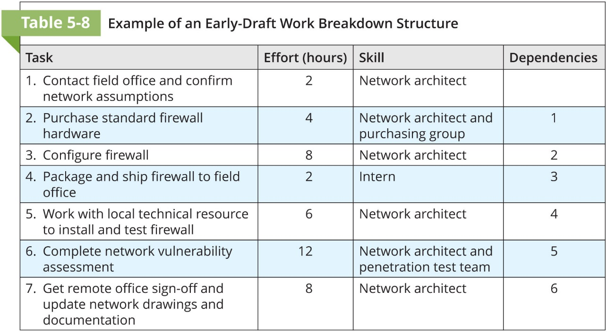

Slide 88
Task Sequencing Approaches
Once a project reaches even a relatively modest size, say a few dozen tasks, there can be almost innumerable possibilities for task assignment and scheduling
A number of approaches are available to assist the project manager in this sequencing effort
One method for sequencing tasks and subtasks in a project plan is known as network scheduling
Network refers to the web of possible pathways to project completion from the beginning task to the ending task

Slide 89
Program Evaluation and Review Technique (PERT)
The most popular of networking dependency diagramming techniques, PERT was originally developed in the late 1950s to meet the needs of rapidly expanding government-driven engineering projects
About the same time, a similar project, called the critical path method, was being developed in industry
It is possible to take a very complex operation and diagram it in PERT if you can answer three key questions about each activity:
How long will this activity take?
What activity occurs immediately before this activity can take place?
What activity occurs immediately after this activity?
By identifying the path through the various activities, you can determine the critical path

Slide 90
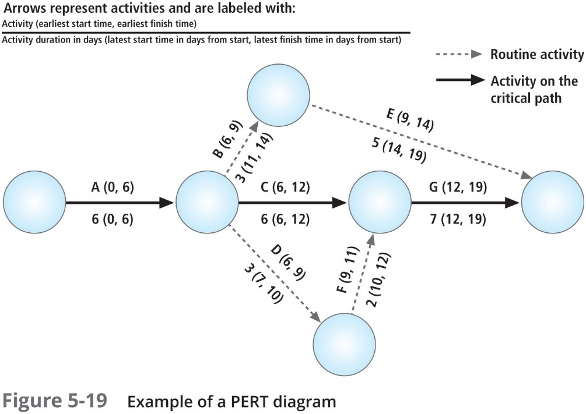

Slide 91
Gantt Chart
Another popular project management tool is the bar or Gantt chart, named for Henry Gantt, who developed this method in the early 1900s
Like network diagrams, Gantt charts are easy to read and understand, and thus easy to present to management
These simple bar charts are even easier to design and implement than the PERT diagrams, and yield much of the same information
The Gantt chart lists activities on the vertical axis of a bar chart, and provides a simple timeline on the horizontal axis

Slide 92
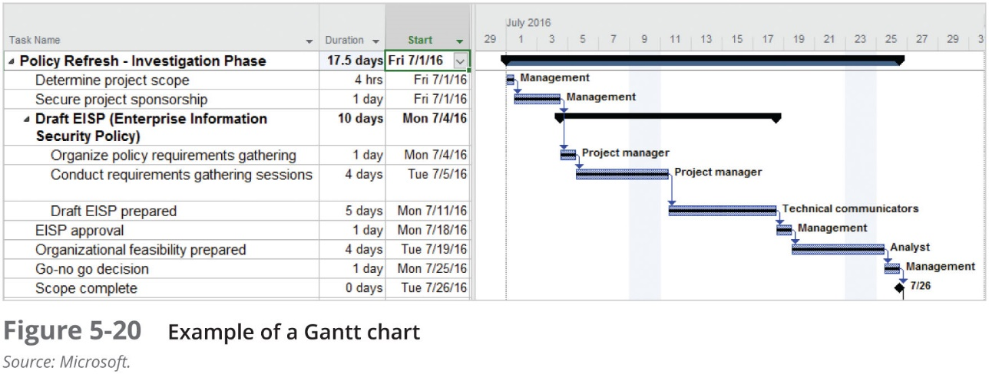

Slide 93
Automated Project Tools
Microsoft Project is a widely used project management tool
If you’re considering using an automated project management tool, keep the following in mind:
A software program cannot take the place of a skilled and experienced project manager who understands how to define tasks, allocate scarce resources, and manage the resources that are assigned
A software tool can get in the way of the work
Choose a tool that you can use effectively

Slide 94
Summary
An InfoSec program describes the structure and organization of the effort to contain risks to the information assets of an organization
In the largest organizations, specific InfoSec functions are likely to be performed by specialized groups of staff members; in smaller organizations, these functions may be carried out by all members of the department. These functions should be separated into four areas:
Functions performed by nontechnical areas of the organization outside the IT area of management control
Functions performed by IT groups outside the InfoSec area of management control
Functions performed within the InfoSec department as a customer service to the organization and its external partners
Functions performed within the InfoSec department as a compliance enforcement obligation
InfoSec needs of an organization are unique to its culture, size, and budget and include personnel and the procedures to be integrated into all human resources (HR) activities, including hiring, training, promotion, and termination practices

Slide 95
Summary (Continued)
Full-time security personnel deployment will vary depending on the organization’s size:
Very large organizations may have more than 20 full-time security personnel and 40 or more individuals with part-time responsibilities
Large organizations will have an average of one to two full-time managers, three to four full-time technicians/administrators, and as many as 16 part-time staff members
Medium-sized organizations may have only one full-time security person and as many as three individuals with part-time responsibilities
Smaller organizations may have either one individual with full-time duties in InfoSec or one individual who is a part-time manager
Selecting an effective mix of InfoSec personnel for your organization requires that you consider a number of criteria, including standardizing job descriptions using standard roles and titles. These titles include CISO or CSO, security managers, security administrators and analysts, security technicians and engineers, security staffers and watchstanders, security consultants, security officers and investigators, and help desk personnel

Slide 96
Summary (Continued)
Many organizations rely to some extent on professional certifications to ascertain the level of proficiency possessed by a given candidate. The more salient certifications include those from the (ISC)², ISACA, the SANS Institute, the EC-Council, and CompTIA
Many InfoSec professionals enter the field after prior careers in law enforcement or the military, after careers in other IT areas, or as college graduates who have tailored their degree programs to specialize in InfoSec
The NICE Cybersecurity Workforce Framework (NCWF) defines a common means of classifying roles in the discipline of cybersecurity
The SETA program is the responsibility of the CISO and is designed to reduce the incidence of accidental security breaches
SETA programs improve employee behavior and enable the organization to hold employees accountable for their actions

Slide 97
Summary (Continued)
Training is most effective when it is designed for a specific category of users. Training includes teaching users not only what they should or should not do but also how they should do it
A security awareness program can deliver its message via videotapes, newsletters, posters, bulletin boards, flyers, demonstrations, briefings, short reminder notices at log-on, talks, or lectures
Project management is the application of knowledge, skills, tools, and techniques to project activities to meet project requirements. Project management is accomplished through the use of processes that include initiation, planning, execution, controlling, and closing
The creation of a project plan can be accomplished using a very simple planning tool, such as the work breakdown structure (WBS)
A set of methods that can be used to sequence the tasks and subtasks in a project plan is known as network scheduling. Popular techniques include PERT, CPM, and the Gantt chart

